Slide 1


DEPARTMENT OF INFORMATION TECHNOLOGY
V R SIDDHARTHA ENGINEERING COLLEGE
Interpreting Doctors Prescription Using
Deep Learning Techniques
Domain : Health Care
B.Tech in INFORMATION TECHNOLOGY
EPICS Project Review Presentation
Presented by :
RIZWANULLAH MD ( 208W1A1299 )
AJAY KUMAR VARMA N ( 208W1A12A1 )
Under the guidance of
DR M SUNEETHA
( Professor & Head )

Slide 2
01
Agenda :
Problem Statement & Objective’s
02
Literature Review
03
Justification for Societal impact
04
Datasets and Software Requirements
05
Architecture Diagram
06
Algorithm
07
Implementation Steps
08
Demonstration of Results and Analysis

Slide 3
Problem Statement
Interpreting Doctors hand written prescription or notes using Deep Learning techniques

Slide 4
Abstract
A Doctor’s Handwriting Recognition model can predict (recognize) the text present in the doctor’s prescription, by feeding image of that medicine name as an input to the model and the model processes the image with deep neural network and it predicts the text present in the image and it gives the final medicine name as digital text.
This model is suitable only for Text written in English Language and not suitable for other languages of texts written in prescription. The model based on training dataset the output it produce may get varied and based on images training count. Both convolution layers and Bi-LSTM layers can be used for feature extraction and recognizing text respectively.
Keywords: Bi-LSTM Layers ,Convolution Layers, Adam optimizer, Batch Normalization.

Slide 5
OBJECTIVE’S OF PROJECT
Solution to digitize the handwritten prescriptions which can also help to integrate tightly with other healthcare systems for seamless digitization and data flow.
The goal of this project is to build a model which accurately recognizes the prescription.

Slide 6
JUSTIFICATION FOR SOCIETIAL IMPACT
It is commonly seen that it is tough to read the handwritten text from medical prescriptions.
This can make it difficult for pharmacists to read the prescription, which can have negative or even fatal consequences if read incorrectly.
Pharmaceutical people can understand handwriting of doctor so that we can avoid any negative consequences like deaths due to misunderstanding of medicine name.

Slide 7
LITERATURE REVIEW
Sno | Paper | Methodology | Year | Algorithm | Result
1 | Recognition of Doctor’s Cursive Handwritten Medical Words | Has developed a model based on Bi-Directional LSTM Model and SRP data augmentation to recognition of Bangladeshi Doctor’s Hand Writing Recognition. | 2021 | Bi-Directional LSTM with SRP Data Augmentation. | A model that can Output the text which is present in the Doctor’s Prescription(Bangladeshi Handwriting).
2 | Handwriting Recognition for Medical Prescriptions | Have developed model based on Bi-LSTM model for hand writing recognition, They used CTC loss functions for Normalization. They passed input to 7 Convolution Layers. | 2021 | Bi-LSTM Model. | A model for predicting Doctor’s Handwriting.

Slide 8
Sno | Paper | Methodology | Year | Algorithm | Result
3 | Medical Handwritten Prescription Recognition Using CRNN | Have Developed model based on Convolutional Recurrent Neural Networks(CRNN).They Trained model with some short texts which contain Alpha- numeric Characters, Spaces etc. | 2019 | Convolutional Recurrent Neural Networks (CRNN). | A model for Interpreting Doctor’s Handwriting, With a Mobile Application.

Slide 9
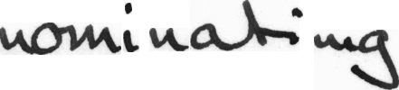



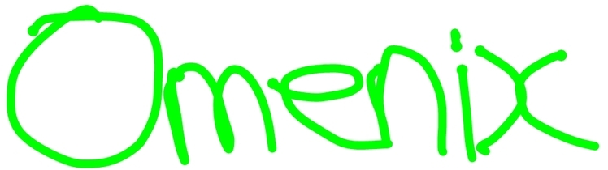
DATASET
Doctors hand writing dataset : https://github.com/rizwanrockzz/epics/tree/main/dataset
IAM hand writing dataset : https://git.io/J0fjL

Slide 10
SOFTWARE REQUIREMENTS
User Requirements:
Dataset acquired from ieee.org
Input is an image with doctor prescription.
Output is digital text displayed on Screen.
Functional Requirements:
Python Programming Language.
Bi directional LSTM model.
Tensorflow,keras Py Libraries.
System Requirements:
Windows Operating System.
Configuration: RAM 8GB with GPU.
Software : VS Code.
Non-Functional Requirements:
Accuracy.
Reliability.
Loss

Slide 11
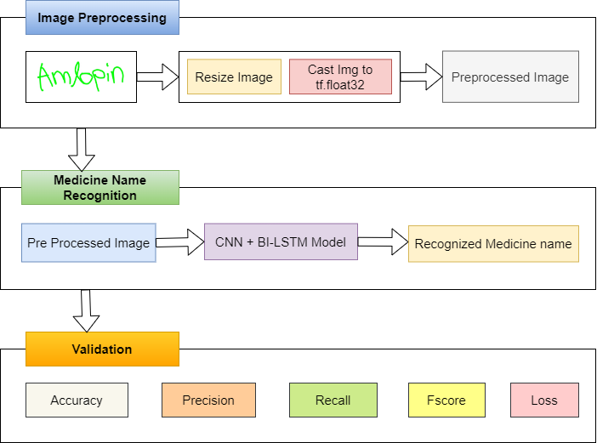
ARCHITECTURE
diagram

Slide 12
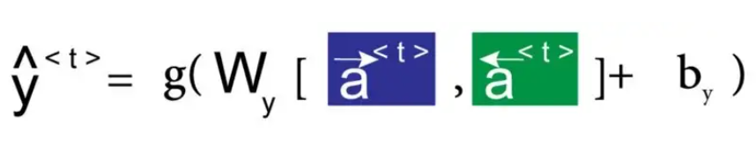
ALGORITHM For Bi-Directional LSTM
Mathematical Equation For Bi-Directional LSTM Model is Below:
Here we apply forward propagation 2 times , one for the forward cells and one for the backward cells
Both activations(forward , backward) would be considered to calculate the output y^ at time t

Slide 13
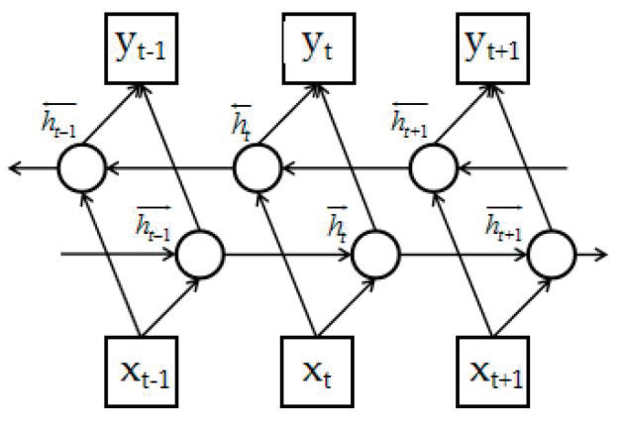
Structure of Bi-Directional LSTM Networks
How cells are connected forward and backward in Bi-Directional LSTM Model

Slide 14
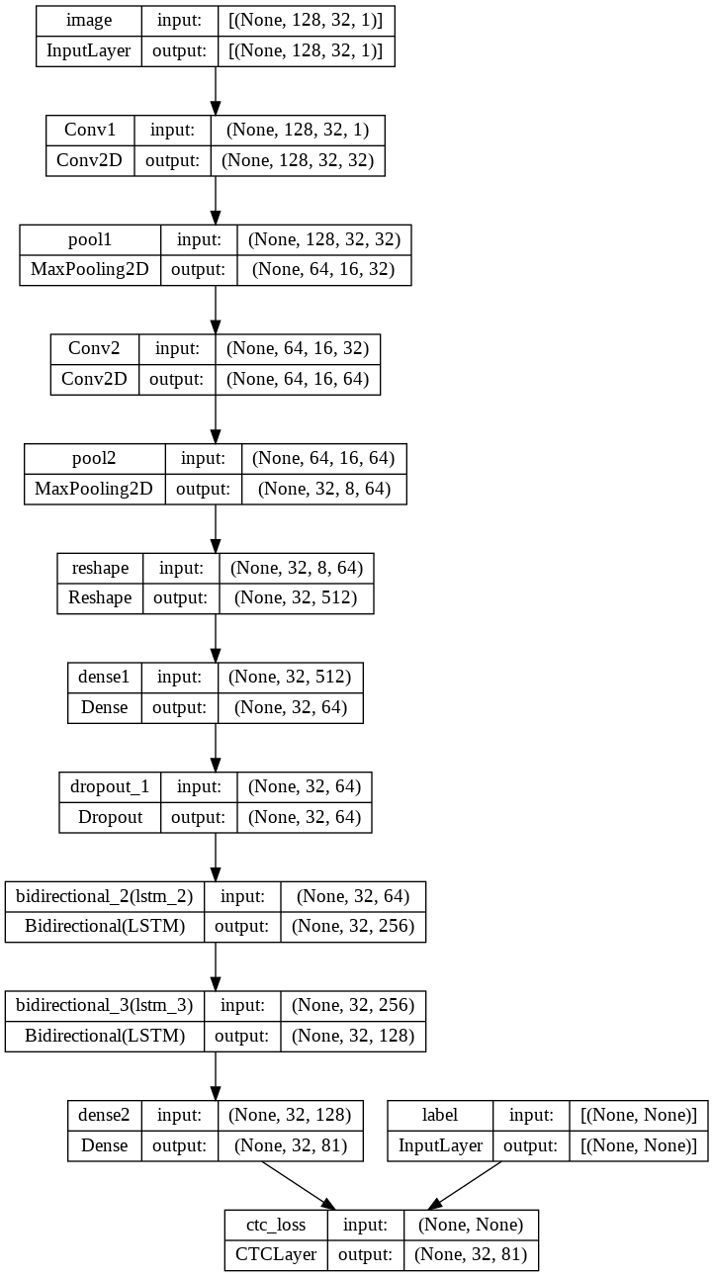
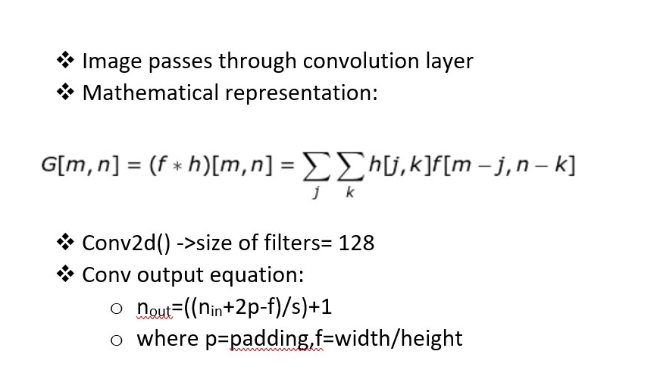

Slide 15
IMPLEMENTATION STEPS
Data collection: Importing Dataset from git repository (IAM dataset)
Importing all required Deep learning related python libraries like Tensorflow, Keras, Matplotlib, Numpy,CV2.
Read the metadata txt file and store the words with “ok” into new array. And then splitting the dataset into 3 parts i.e Training, Validation, testing samples with ratios ( 70:15:15 & 80:10:10 & 90:5:5)
Find maximum length and the size of the vocabulary in the training data. Then build character vocabulary.
Resizing the images without distortion in a rectangular size.

Slide 16
Set image width to 128,height to 32,Batch size to 64 and padding token to 99.
Code for pre processing image, Vectorizing image labels, process image labels and for prepare dataset.
Build model with 2 Convolution layers, 2 Max Pooling layers, Add Reshape, Dense and dropout layer, Add 2 Bi directional LSTM layers with filter value as 128, 64 and dropout to 0.25.
Now, Add 2nd Dense layer with “Soft-max” activation. And finally add ctc layer for calculating ctc loss at each step
Set Optimizer to “Adam” and then build the model.
Now add Evaluation metrics, validation images and validation labels. And then create a callback to monitor the edit distances.
Now, Build model and then set epoch value and fit model.And train the model.
Now take images from testing set and pass them to input layer and predict them. Then, we can get output of predicted text by model.
Now plot a graph for Value loss function loss vs var_loss.

Slide 17
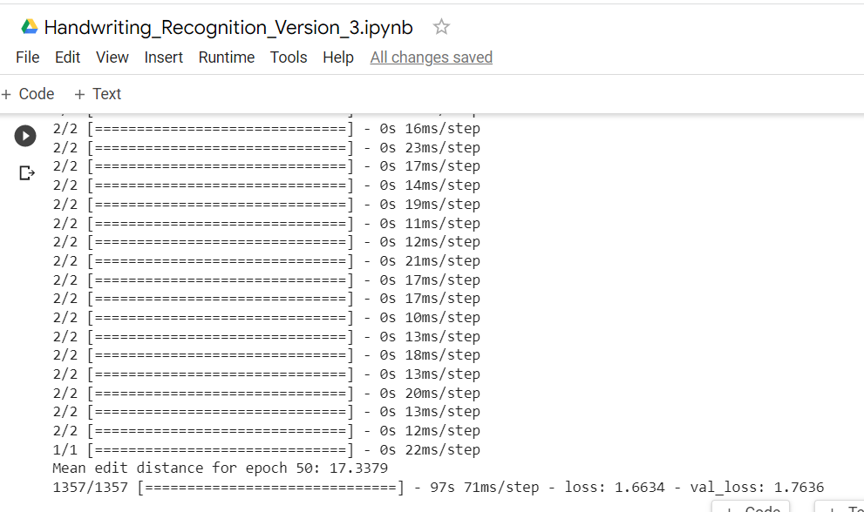
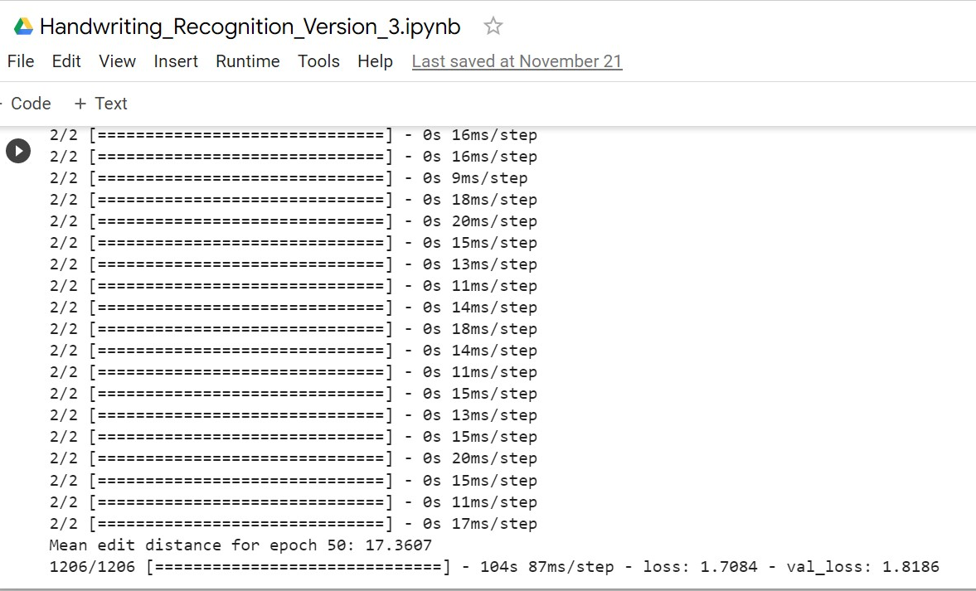
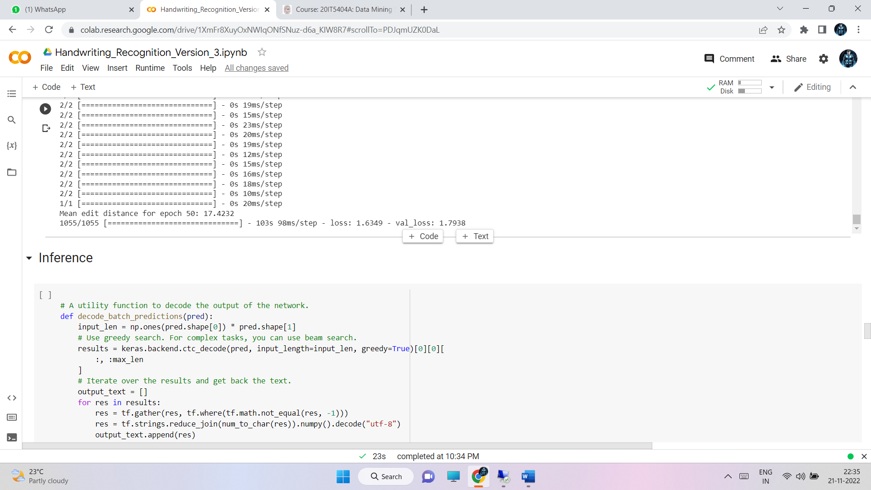
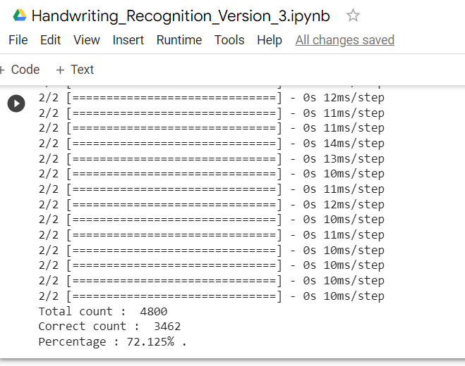
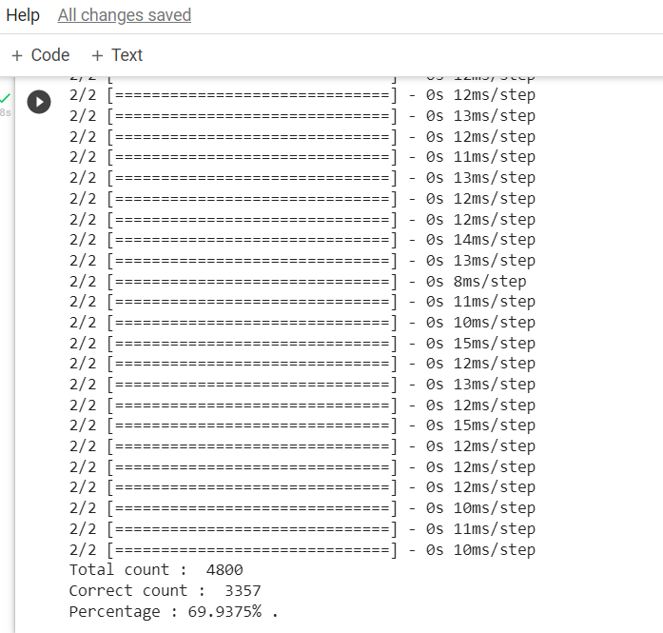
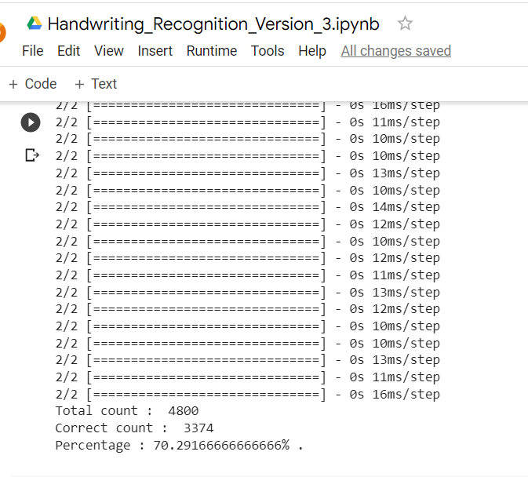
Demonstration of result & analysis
90:5:5 with Epoch 50
80:10:10 with Epoch 50
70:15:15 with Epoch 50

Slide 18
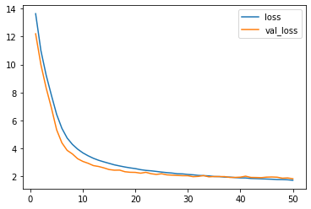
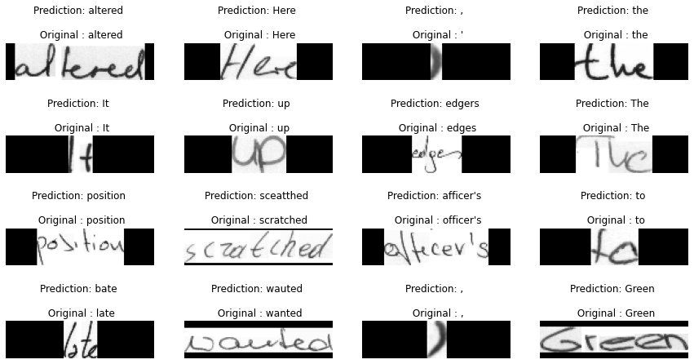
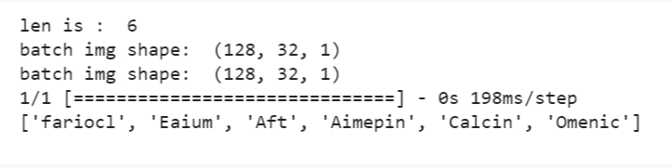
Custom inputs

Slide 19
Analysis
Ratios (train : validation : testing) | Highest Accuracy epoch
70:15:15 | 50
80:10:10 | 50
90:5:5 | 50
70:15:15
80:20:20
90:5:5
Epoch | Accuracy (%)
30 | 66.90
40 | 69.29
50 | 70.29
Epoch | Accuracy (%)
30 | 70.52
40 | 69.93
50 | 71.25
Epoch | Accuracy (%)
30 | 70.67
40 | 71.93
50 | 72.12
The model got 72.12% accuracy when data splitting ratio is 90:5:5 with epoch 50

Slide 20
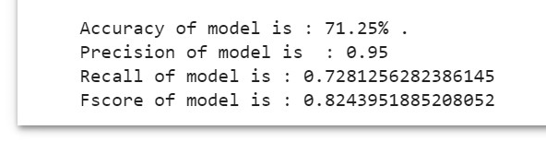
VALIDATION Analysis
Accuracy : 72.12% for (90:5:5) with epoch : 50
Precision : 0.95
Recall : 0.728
FScore : 0.824

Slide 21
CONCLUSIONS and future scope
Finally this model helps pharmacists and normal people to recognize the medicine name accurately in the doctor’s handwritten prescription .
The accuracy for this model can be further improved by training with more handwritten prescriptions.
Further an API can be created for this model which can be useful mobile applications and web application to use this model for recognizing text from prescription.

Slide 22
REFERENCES
[1] Shaira Tabassum1, Ryo Takahashi1 , Md Mahmudur Rahman “Recognition of Doctors’ Cursive Handwritten Medical Words by using Bidirectional LSTM and SRP Data Augmentation”,IEEE | DOI: 10.1109/TEMSCON EUR52034.2021.9488622
[2] Tanvish Jain,Rohan Sharma,Ruchika Malhotra,” Handwriting Recognition for Medical Prescriptions using a CNN-Bi-LSTM Model” DOI: 10.1109/I2CT51068.2021.9418153
[3] Lovely Joy Fajardo1, Niño Joshua Sorillo , Jaycel Garlit , Cia Dennise Tomines , Mideth B. Abisado , Joseph Marvin R. Imperial , Ramon ,” Doctor’s Cursive Handwriting Recognition System Using Deep Learning” DOI:10.1109/HNICEM48295.2019.9073521
[4] L. J. Fajardo et al, "Doctor’s Cursive Handwriting Recognition System Using Deep Learning," 2019 IEEE 11th International Conference on Humanoid, Nanotechnology, Information Technology, Communication and Control, Environment, and Management ( HNICEM ), 2019, pp. 1-6, DOI: 10.1109/HNICEM48295.2019.9073521

Slide 23
Thank You

